Slide 1
TOC Theory of Computation

Slide 2
Introduction to Theory of Computation
It is one of the most important subjects form theoretical computer science
It has alone weightage of 12 marks out of 70 technical marks in GATE
Not only GATE, any other competitive exam this subject has very strong weight age
Not only written exam but even you also go through an interview either for job or for further study, this subject give strong weightage

Slide 3
BOOKS
Hopcroft, John E., Rajeev Motwani, and Jeffrey D. Ullman. "Introduction to automata theory, languages, and computation." (2001).
“Introduction to Formal Languages, Automata Theory and Computation” by R Rama, Kamala Krithivasan

Slide 4
What is computation
Computation means we write some programs and we execute those programs
Fundamental activity behind the computation or the way computation is carried out by executing programs
What is program
Programs express algorithms

Slide 5
What is algorithms
Algorithm are steps by steps procedure for carrying out input to output transformation
input
output
Algorithm
x
f(x)
Every algorithms compute function
Function is mapping from some domain to range
f:D→R
Domain is domain of all inputs
Range is Range of all outputs

Slide 6
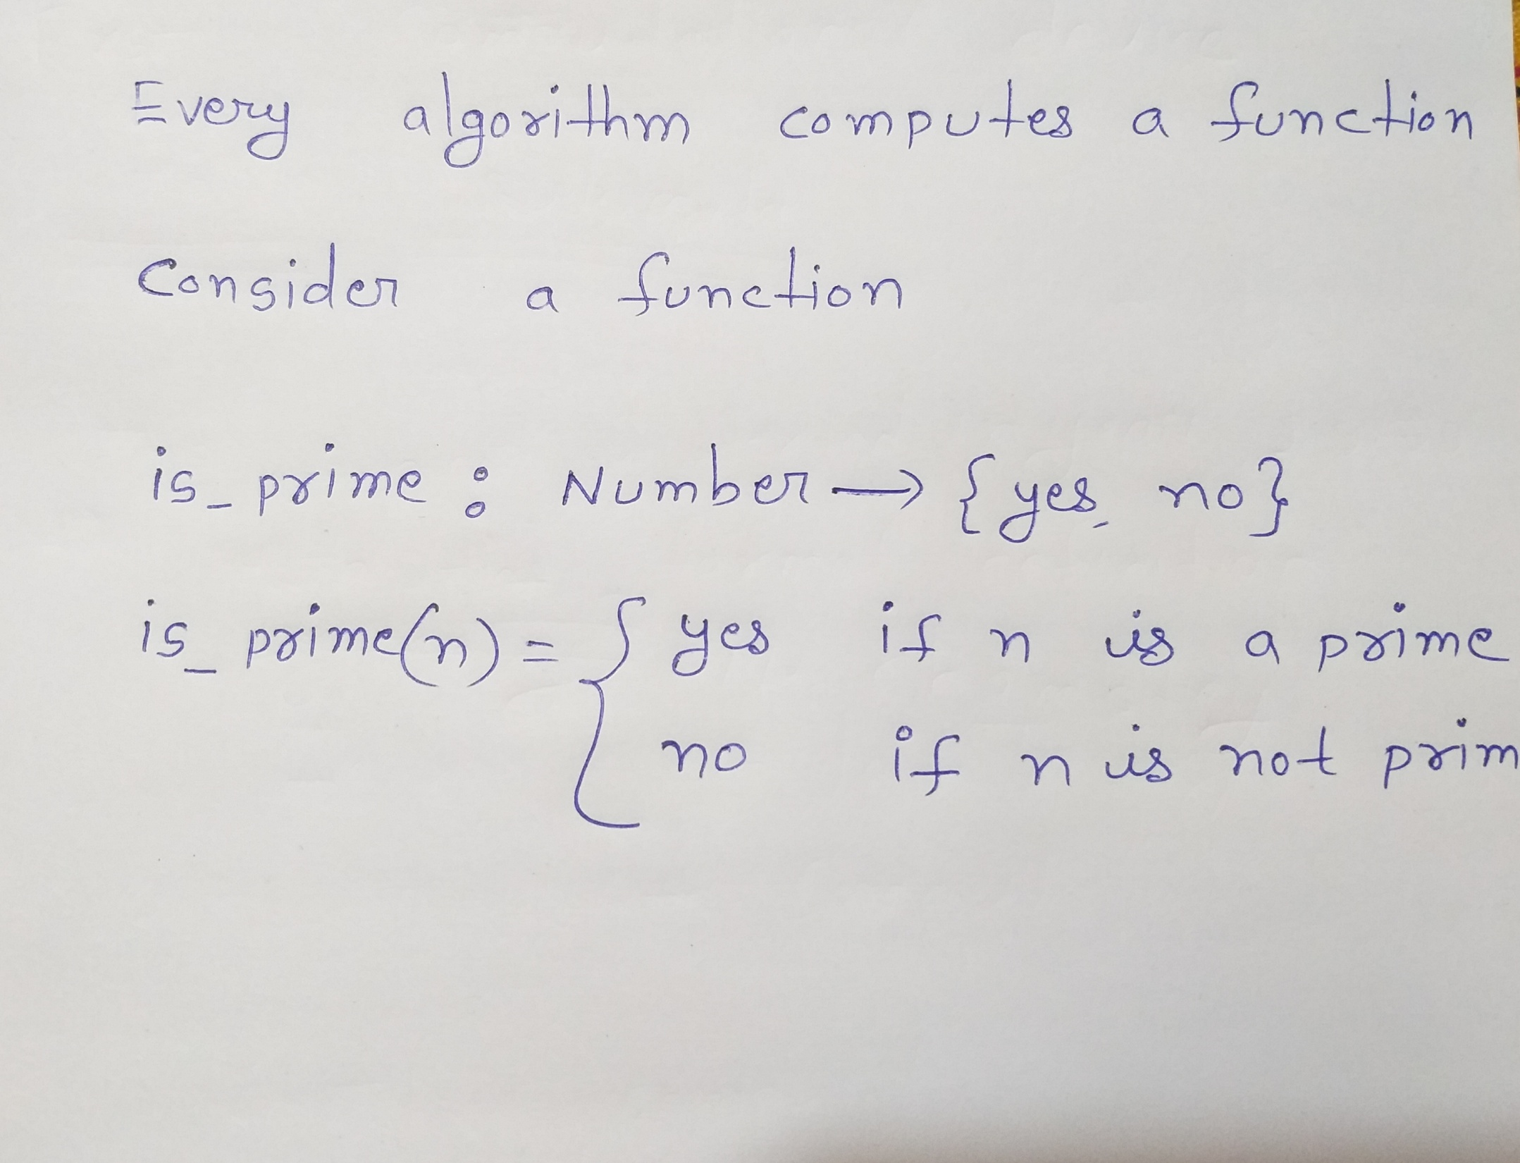

Slide 7
Basic Goal
To identify the class of function which admit the algorithm to compute them
{For function f, there is an algorithm to compute function f
{Rest do not admit any algorithms to compute the function
Most of function do not admit any algorithm,
This will see at the end of the course

Slide 8
Set Membership Problem
S : a set
Given any a, to decide if a is member of set S or not

Slide 9
Basic Terminologies
Symbol: Symbols are indivisible objects or entity that cannot be defined. A symbol is any single object . Symbol is smallest building block of TOC.
Ex: 0,1,a,b
Alphabet: An alphabet is a finite set of symbol. The alphabet of a language is normally denoted by
Ex:
String: A string or word over an alphabet is a finite sequence of concatenated symbols of
Ex:
0110, 11, 001 are three strings over the binary alphabet { 0, 1 } .
aab, abcb, b, cc are four strings over the alphabet { a, b, c }.

Slide 10
Formal Language:
A formal language L over the alphabet is a subset of
Ex:

Slide 11
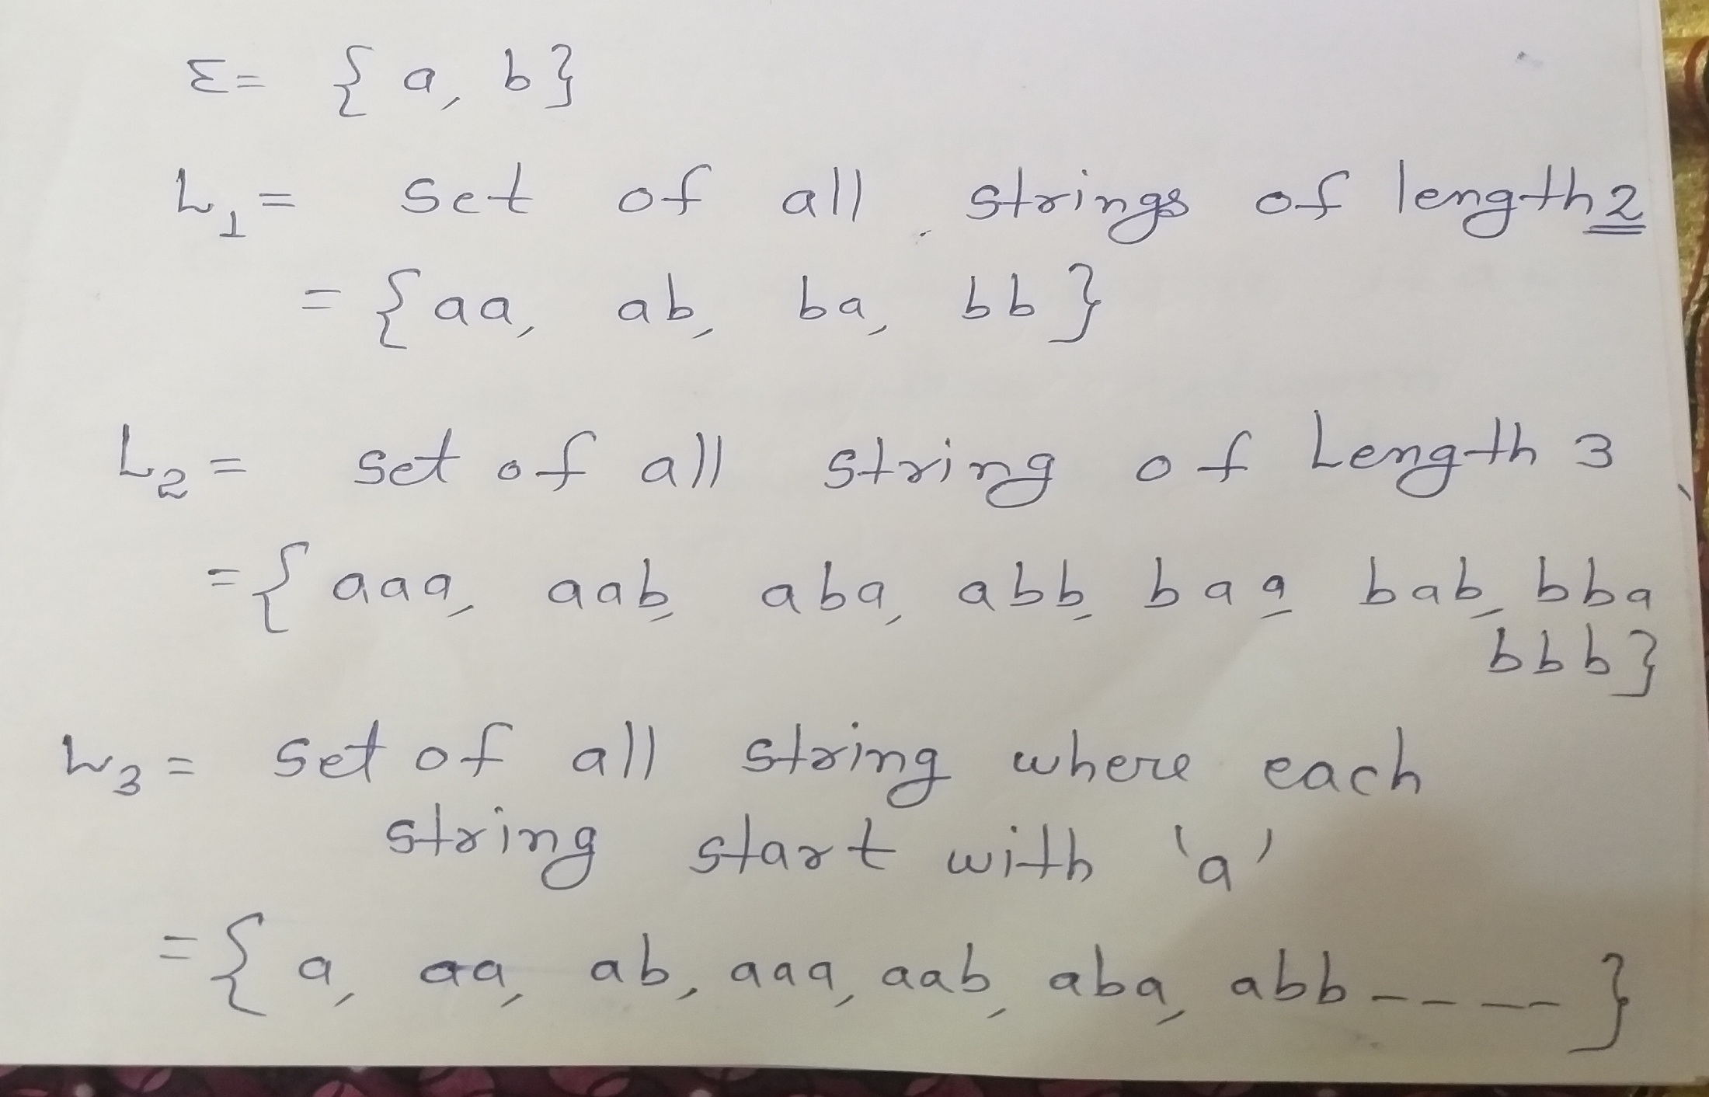
A language formed over can be finite or infinite

Slide 12
Power of
set of all strings over of length exactly 1
= { a, b}
set of all strings over of length exactly 2
= {aa, ab, ba,bb}
set of all strings over of length exactly 3
= {aaa, aab, aba,abb,baa,bab,bba, bbb}
set of all strings over of length exactly n
set of all strings over of length exactly 0
= That is called epsilon

Slide 13
is an alphabet
Denotes the sets of all finite strings over

Slide 14
Language is finite
is length of all strings of length 2
is length of all strings of length 2
String(s)={aaa} is present in this or not
If language is finite then machine can easily do it

Slide 15
Language is infinite
is length of all strings of start with a
String(s)={baaa} is present in this or not
If language is infinite then machine takes lots of times

Slide 16
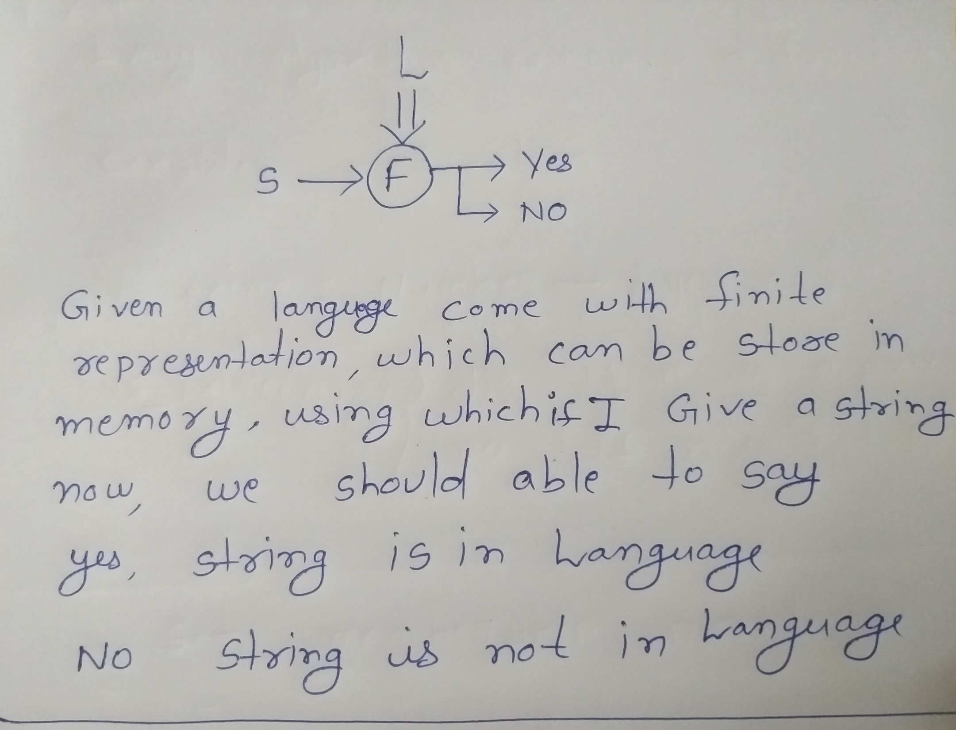

Slide 17
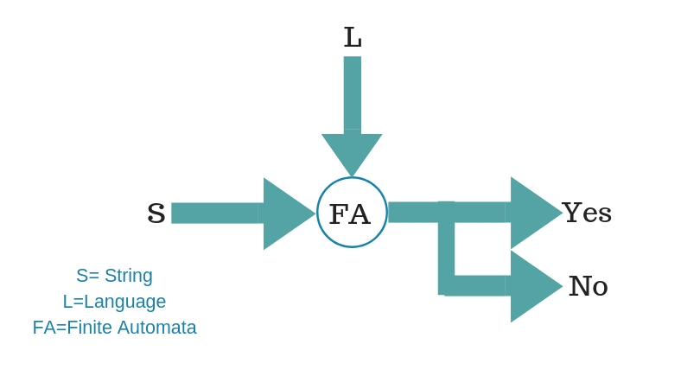
What is Finite Representation/ Finite Automata
Finite Automata(FA) is the simplest machine to recognize patterns

Slide 18
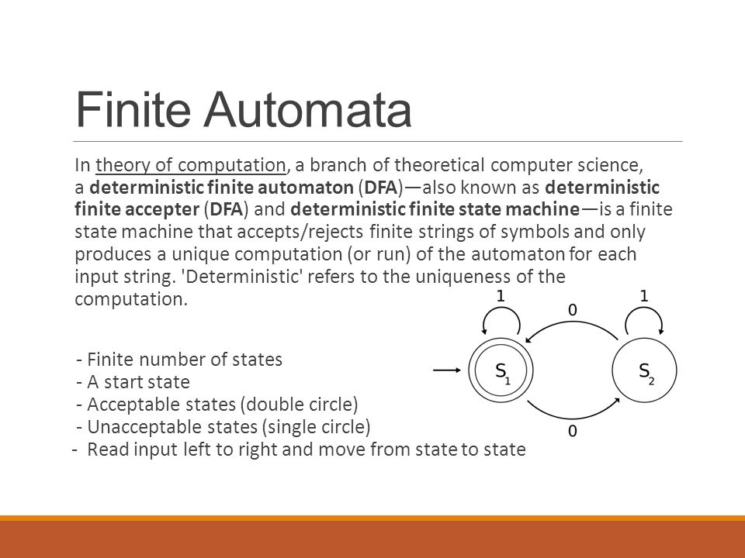

Slide 19
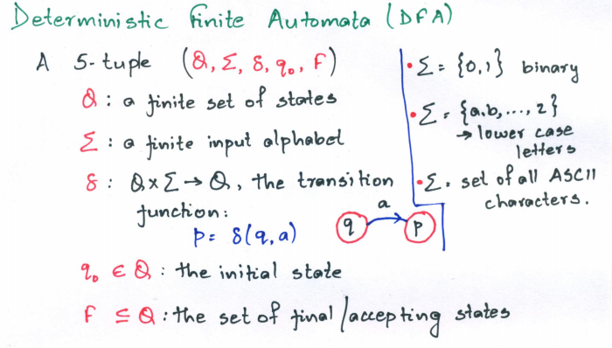

Slide 20
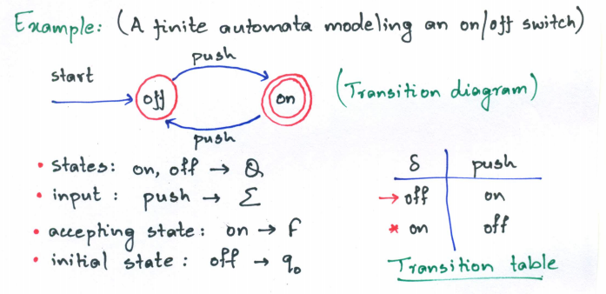

Slide 21
